Slide 1
UNIT III – OpenFlow, Programmability and the Management Interface
UNIT I – SESSION 1
SESSION 1
OpenFlow Overview-
The OpenFlow Switch
The OpenFlow Controller
The OpenFlow Protocol
Reference: Ref. 1, Ch. 5.2.1 to 5.2.3

Slide 2
Introduction
OpenFlow is a distinct subset of the technologies included under SDN.
OpenFlow defines both the communications protocol between the SDN data plane and the SDN control plane, as well as part of the behavior of the data plane.
An OpenFlow system consists of an OpenFlow controller that communicates to one or more OpenFlow Switches.

Slide 3
Overview
Open Network Foundation (ONF) was created for the express purpose of accelerating the delivery and commercialization of SDN.
openflow.org
OpenFlow is an attempt to allow the programming, for the implementations of switches.

Slide 4
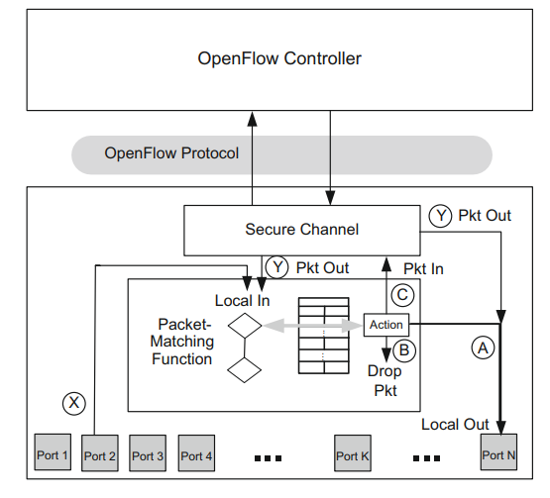
The OpenFlow V 1.0 Switch
decision logic

Slide 5
The OpenFlow Switch
Figure depicts the basic functions of an OpenFlow V.1.0 switch and its relationship to a controller.
As would be expected in a packet switch, we see that the core function is to take packets that arrive on one port (path X on port 2 in the figure) and forward it through another port (port N in the figure), making any necessary packet modifications along the way.
A unique aspect of the OpenFlow switch is embodied in the packet-matching function shown in Figure.
The adjacent table is a flow table. The wide, gray, double arrow in Figure starts in the decision logic, shows a match with a particular entry in that table, and directs the now-matched packet to an action box on the right.

Slide 6
This action box has three fundamental options for the disposition of this arriving packet:
  A. Forward the packet out a local port, possibly modifying certain header fields first.
  B. Drop the packet.
  C. Pass the packet to the controller.
In the case of path C, the packet is passed to the controller over the secure channel shown in the figure.
If the controller has either a control message or a data packet to give to the switch, the controller uses this same secure channel in the reverse direction.
When the controller has a data packet to forward out through the switch, it uses the OpenFlow PACKET_OUT message.

Slide 7
We see in Figure that such a data packet coming from the controller may take two different paths through the OpenFlow logic, both denoted Y .
In the rightmost case, the controller directly specifies the output port and the packet is passed to that port N in the example.
In the leftmost path Y case, the controller indicates that it wants to defer the forwarding decision to the packet-matching logic.
A given OpenFlow switch implementation is either OpenFlow-only or OpenFlow-hybrid.
An OpenFlow-only switch is one that forwards packets only according to the OpenFlow logic described above.
An OpenFlow hybrid is a switch that can also switch packets in its legacy mode as an Ethernet switch or IP router.

Slide 8
The OpenFlow Switch
One can view the hybrid case as an OpenFlow switch residing next to a completely independent traditional switch.
Such a hybrid switch requires a preprocessing classification mechanism that directs packets to either OpenFlow processing or the traditional packet processing.
It is probable that hybrid switches will be the norm during the migration to pure OpenFlow implementations.

Slide 9
The OpenFlow Controller
Modern Internet switches make millions of decisions per second about whether or not to forward an incoming packet, to what set of output ports it should be forwarded, and what header fields in the packet may need to be modified, added, or removed. This is a very complex task.
The switching network is splitted into the pure data plane from the control plane.
The data plane matches headers, modifies packets, and forwards them based on a set of forwarding tables and associated logic, and it does this very, very fast.(even 100 Gbps ).
The control plane runs routing and switching protocols and other logic to determine what the forwarding tables and logic in the data plane should be.
This process is very complex and cannot be done at line rates

Slide 10
OpenFlow control plane
The OpenFlow control plane differs from the legacy control plane in 3 key ways.
  First, it can program different data plane elements with a common, standard language, OpenFlow.
  Second, it exists on a separate hardware device than the forwarding plane, unlike traditional switches, where the control plane and data plane are instantiated in the same physical box. This separation is made possible because the controller can program the data plane elements remotely over the Internet.
  Third, the controller can program multiple data plane elements from a single control plane instance.
  The OpenFlow controller is responsible for programming all the packet-matching and forwarding rules in the switch.

Slide 11
Whereas a traditional router would run routing algorithms to determine how to program its forwarding table, that function or an equivalent replacement to it is now performed by the controller.
Any changes that result in recomputing routes will be programmed onto the switch by the controller.

Slide 12
The OpenFlow Protocol
The OpenFlow protocol defines the communication between an OpenFlow controller and an OpenFlow switch.
The protocol consists of a set of messages that are sent from the controller to the switch and a corresponding set of messages that are sent in the opposite direction.
Collectively the messages allow the controller to program the switch so as to allow fine-grained control over the switching of user traffic.
The most basic programming defines, modifies, and deletes flows.
Recall that we defined a flow as a set of packets transferred from one network endpoint to another endpoint.
The endpoints may be defined as IP address-TCP/UDP port pairs, VLAN endpoints, layer three tunnel endpoints, or input ports, among other things

Slide 13
One set of rules describes the forwarding actions that the device should take for all packets belonging to that flow.
When the controller defines a flow, it is providing the switch with the information it needs to know how to treat incoming packets that match that flow.
The possibilities for treatment have grown more complex as the OpenFlow protocol has evolved, but the most basic prescriptions for treatment of an incoming packet are denoted by paths A, B, and C in Figure.
These three options are to forward the packet out one or more output ports, drop the packet, or pass the packet to the controller for exception handling.

Slide 14
OpenFlow was viewed primarily as an experimental platform in its early years.
For that reason, there was little concern on the part of the development community in advancing this standard to provide for interoperability between releases.
As OpenFlow began to see more widespread commercial deployment, backward compatibility has become an increasingly important issue.
Many features, however, were introduced in earlier versions of OpenFlow that are no longer present in the current version

